Slide 1
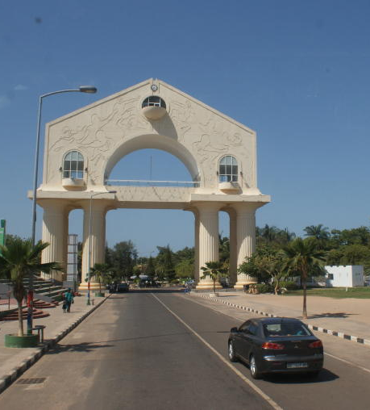
PASSO Turning the fare handout into a digital solution
Abd Al-Ala Camara
4 months
Figma, Whimsical, Miro, Zapline, Lookback

Slide 2
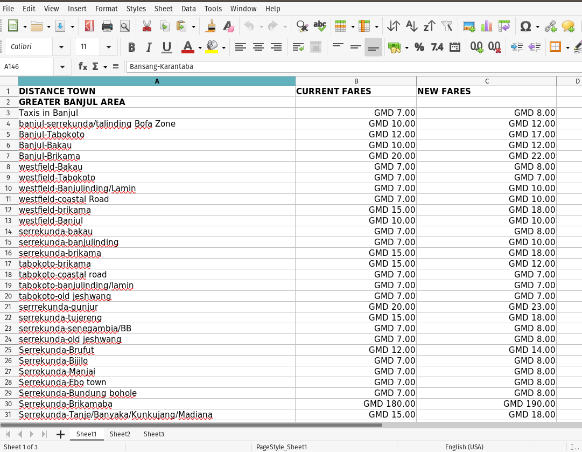
Problem Overview
The Ministry of Transportation created and distributed a fare handout listing all the fares in the country; Base on the background in my research plan, users (passengers and drivers/apprentice) used the fare handout as a single source of truth to settle disputes among themselves. But the handout, in turn, causes more problems due to the following reasons:
- Different users have different copies of the handout.
- The fare handout is six pages long; checking the fare from one locality to the other takes time.
- You can't carry it all the time.
- 30% of the passengers don't know a fare handout exists from the Ministry.
I want to help the Ministry by turning the six pages fare handout into a digital solution by designing an experience that allows users to check the fare from one place to another.

Slide 3
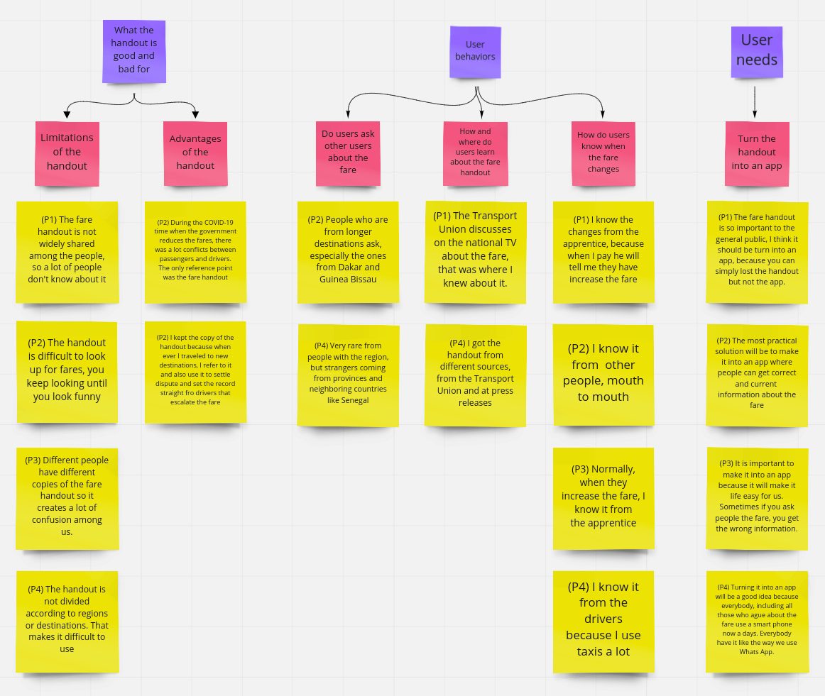
Discovery: Research & Analysis
Before jumping into drawing screens, I want to be sure that I'm addressing the user's needs and unpack the insights; I have crafted a research plan and conducted in-person and phone interviews with peoples who regularly use the public transportation system.
I used active listening to condense all of the respondent's data into atomic nuggets that are easy to understand.
Key Finding
With all the problems around the fare handout, passengers always kept a copy of the fare handout to refer to it to settle disputes with the drivers or apprentices.

Slide 4
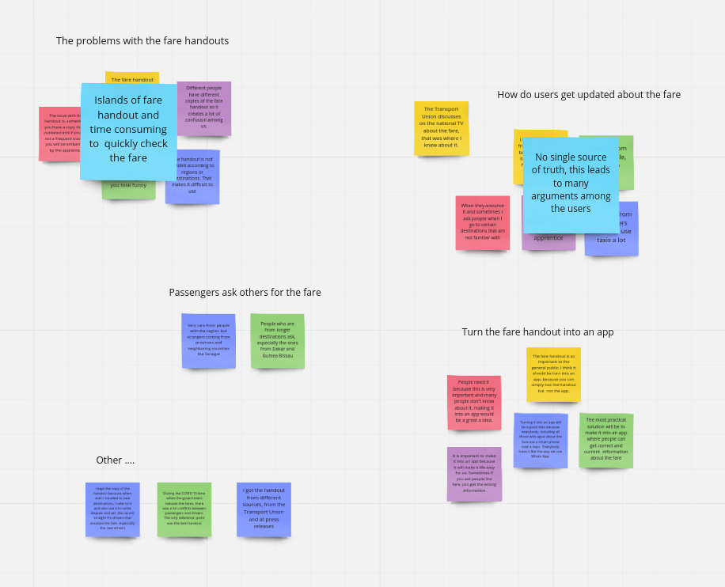
Design: Concepts & Sketching
After completing active listening, I use a technique called affinity mapping (with miro) to gather all of the insights, cluster similar thoughts together, and named the clusters into themes. This process helps me see what exists across various users and various types of data and draw patterns to generate meaningful solutions.
From the themes, I have identified a few opportunity areas. For example, "How do users get updated about the fare?" has a great opportunity because there is no single source of truth of the fare handout.

Slide 5
Design: Concepts & Sketching
# | Term | Description
00 | Simple and intuitive search | A simple and quick FROM and TO fare search form
01 | Simple Results | A simple fare results dialog
02 | Clear and ease of use | A clear filterable listing of all fares within the country showing the regions, different vehicles types, and the fare
03 | Administration | A back office for the authorities to add new users, new localities and update the fares
04 | Notification system | Push notifications ones the authorities change the fare
05 | Authentication & Authorisation | Authenticate users with sign In and reset password if forgotten
06 | Historical Data | Keep the previous fares for historical reason
07 | Feedback | A feedback form for users to let authorities know about new localities or places discovered.
08 | Personalization & contribution | A WhatsApp widget for live chat with authorities concerning disputes and for the authorities to take measures to solve it
Feature Ideation
I used the Crazy-8 technique to focus my creativity and came up with some wild ideas on paper.
Finally, I came up with a single How might we question.
How might we provide a digital single and updated source of truth for passengers so they can quickly check the fare (know how much to pay) from one locality to the other?

Slide 6
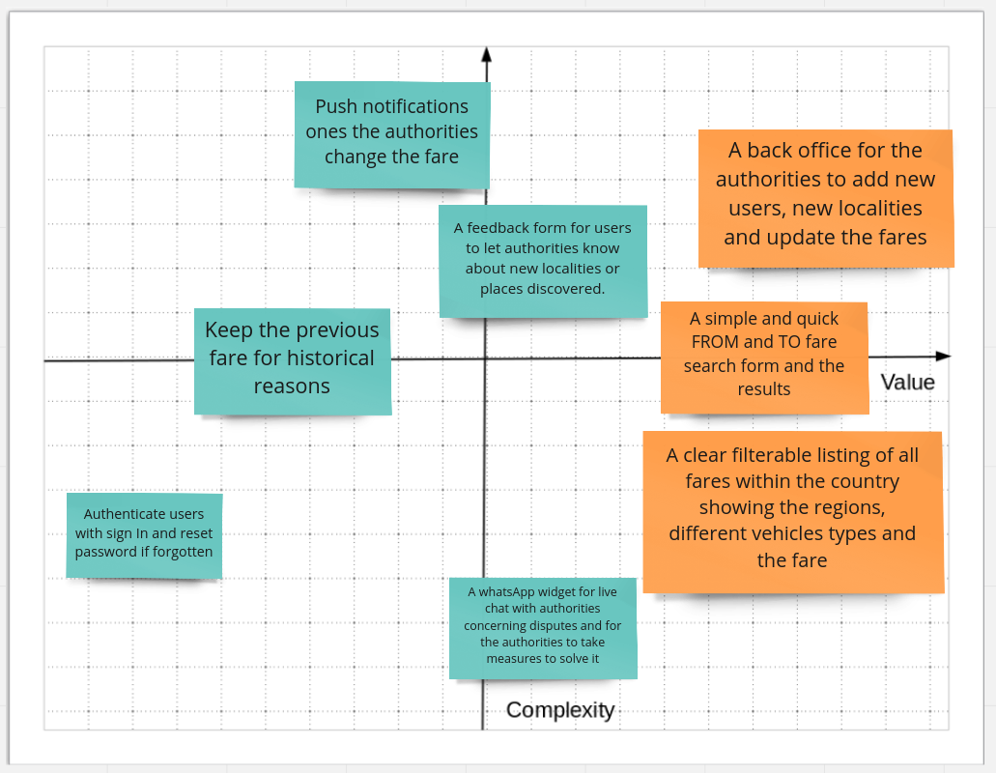
Design: Concepts & Sketching
Feature Prioritization
After having some opportunity areas, I use the Value Vs. Complexity Quadrant to prioritization three features to implement.
Based on the feature ideation and prioritization, the challenge for this project was to design:
1. A simple, easy, and quickest way for users to search how much the fare is.
2. A clear and filterable listing of all the fares with different vehicle types, localities with regions within the country.
3. A back office for the authorities to add new users, new localities and update the fares.

Slide 7
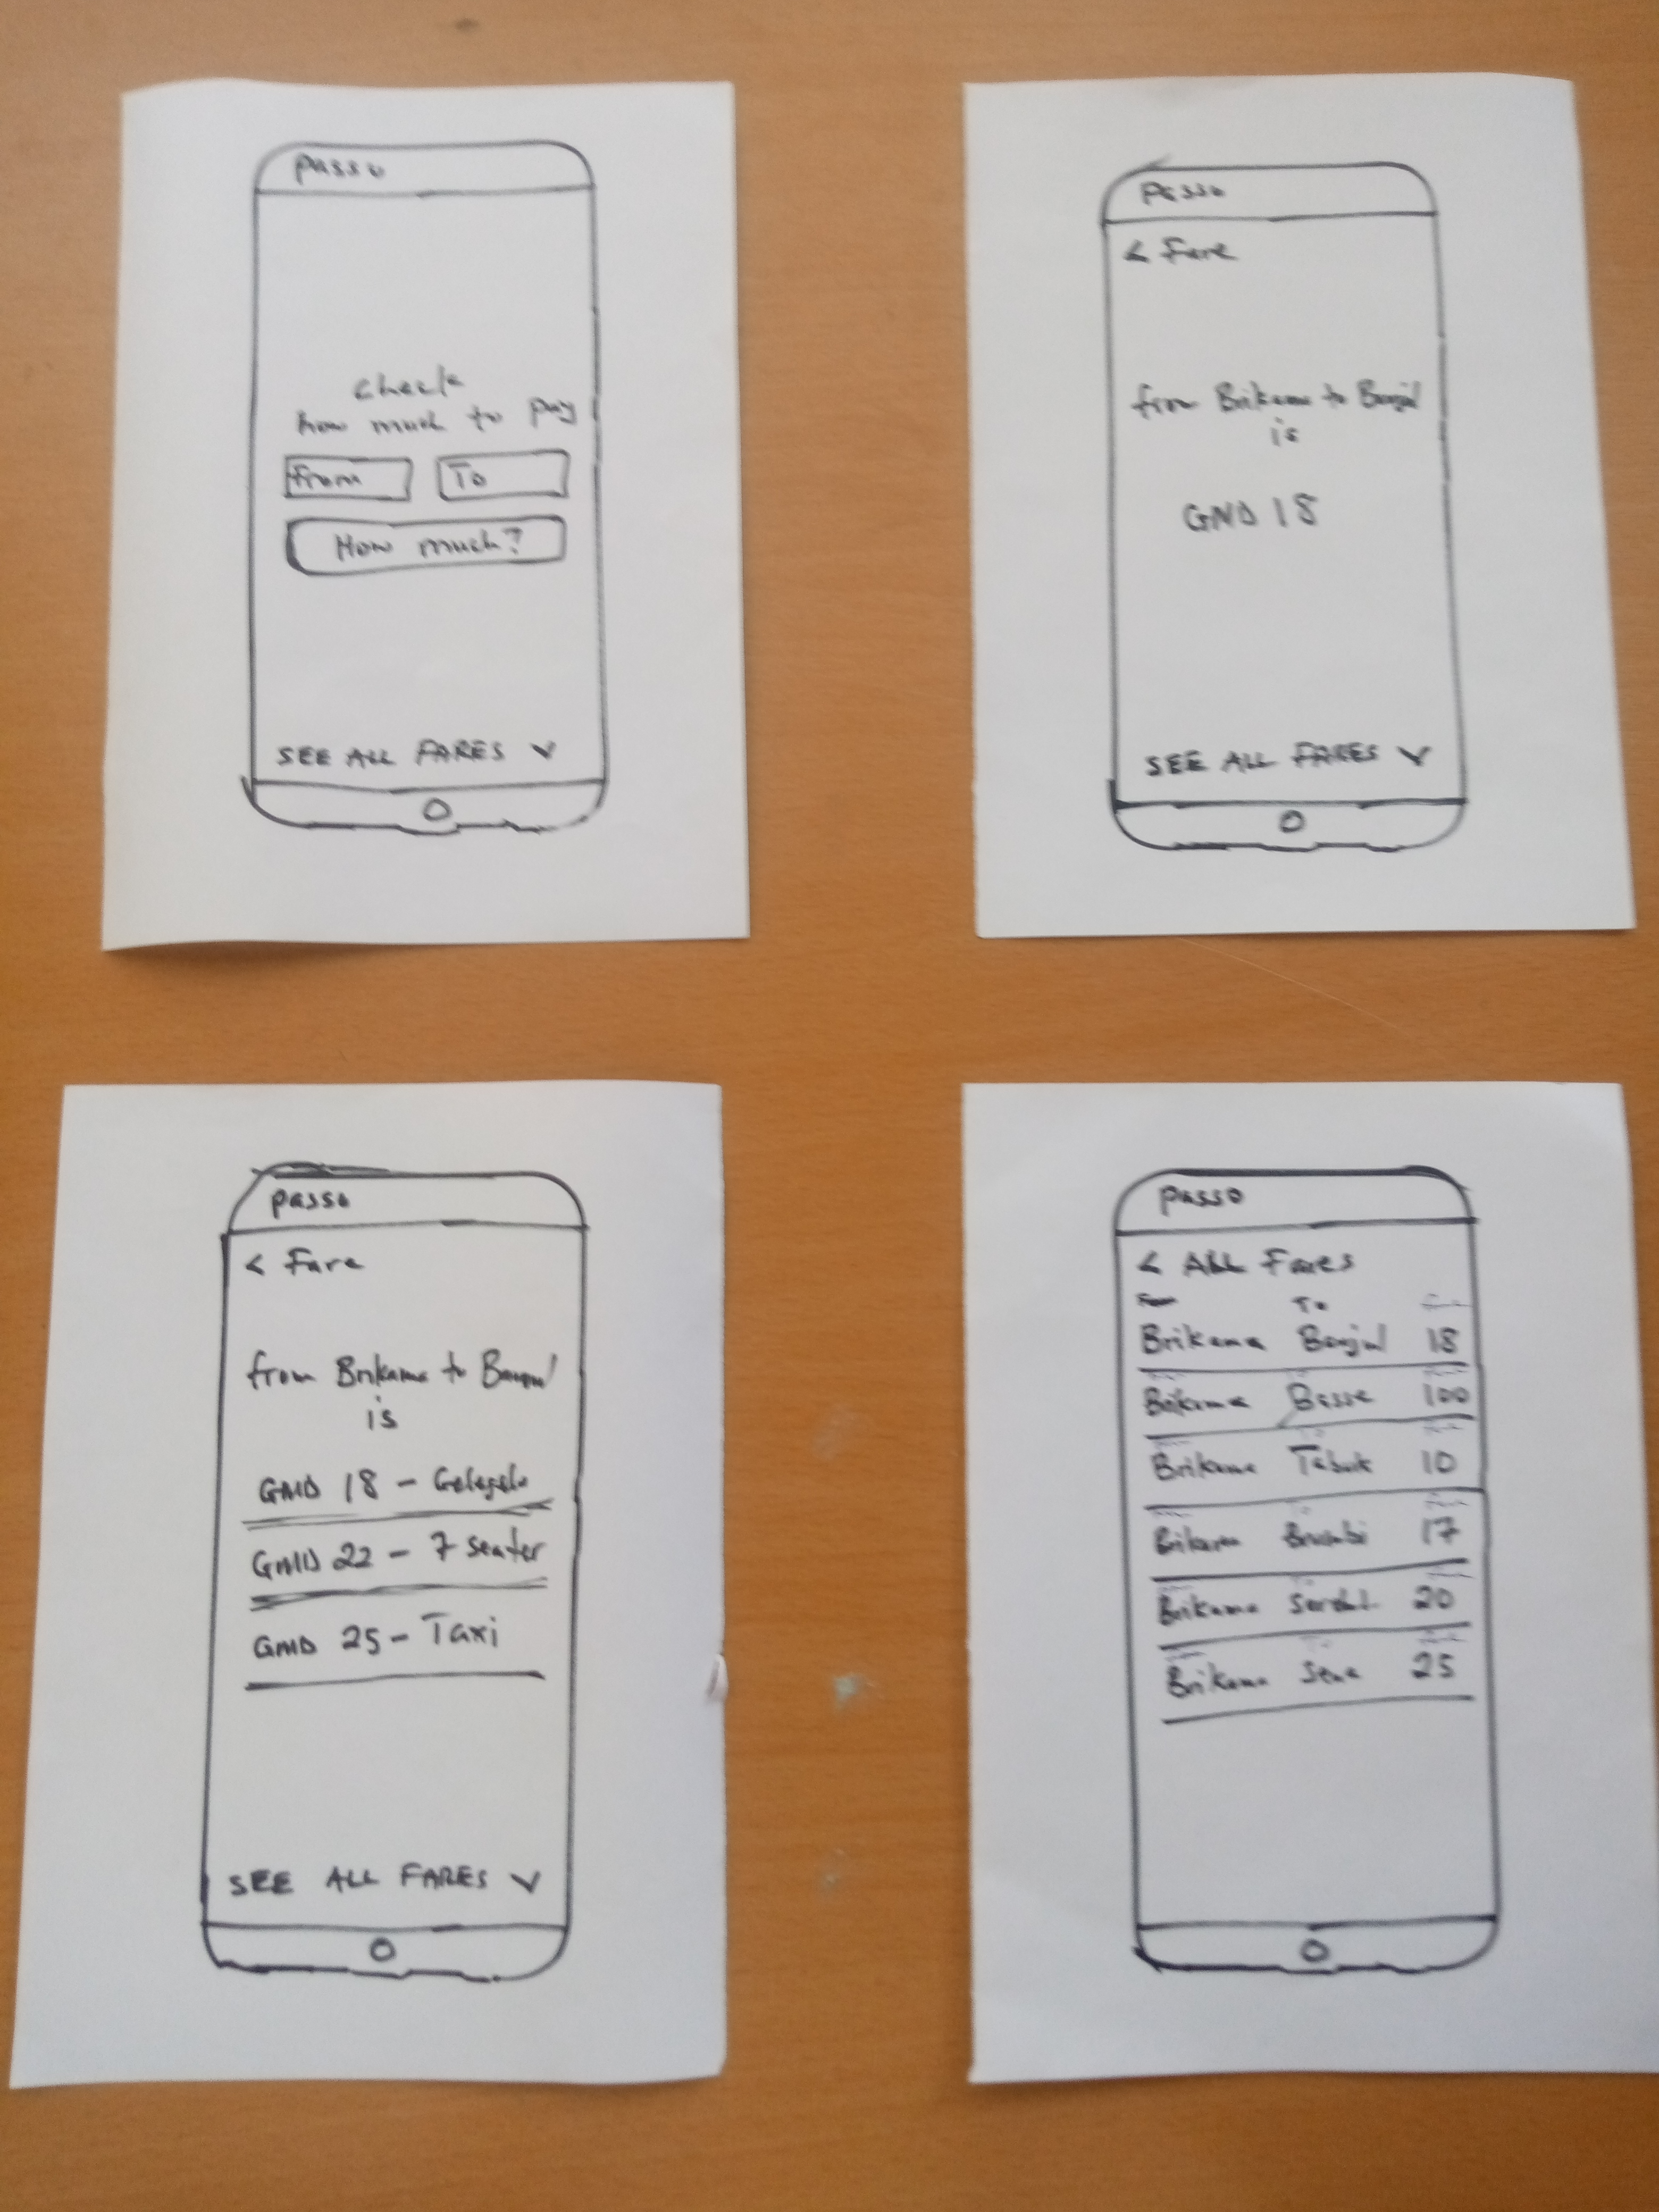
Design:
Concepts & Sketching
Paper Sketches
Outputs from synthesis gave me a clear problem definition. Next up, I started sketching on paper to demonstrate the ideas of user's needs.

Slide 8
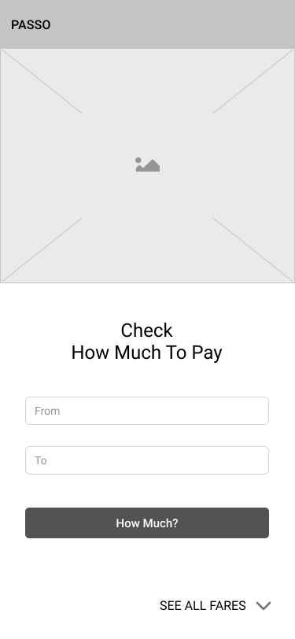
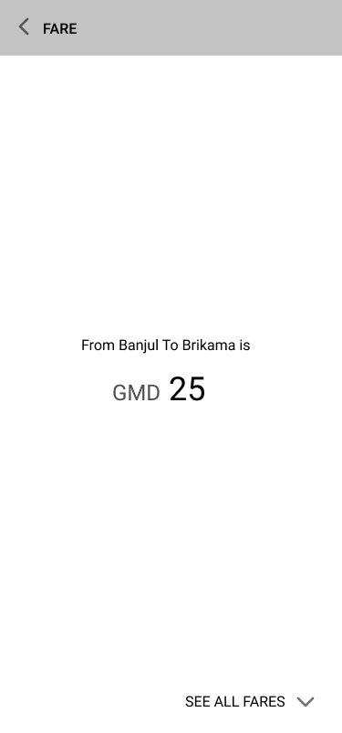
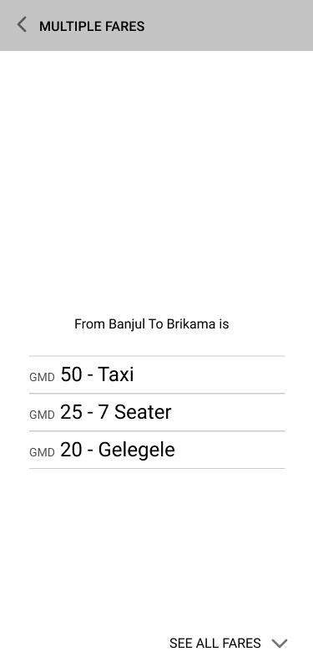
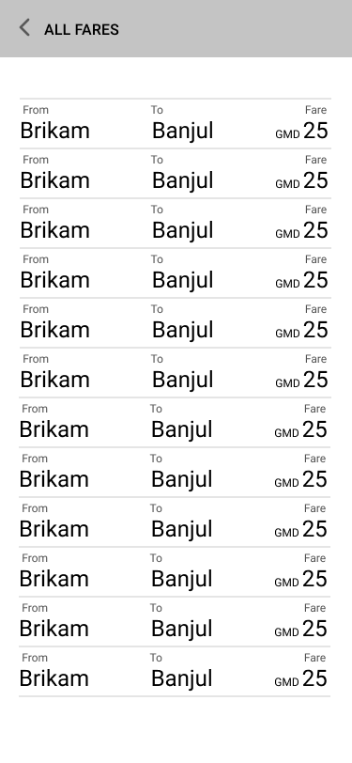
Design: Concepts & Sketching
Low-fidelity Wireframes
Up next, I move on to do the final sketches into low-fidelity wireframes using figma.

Slide 9
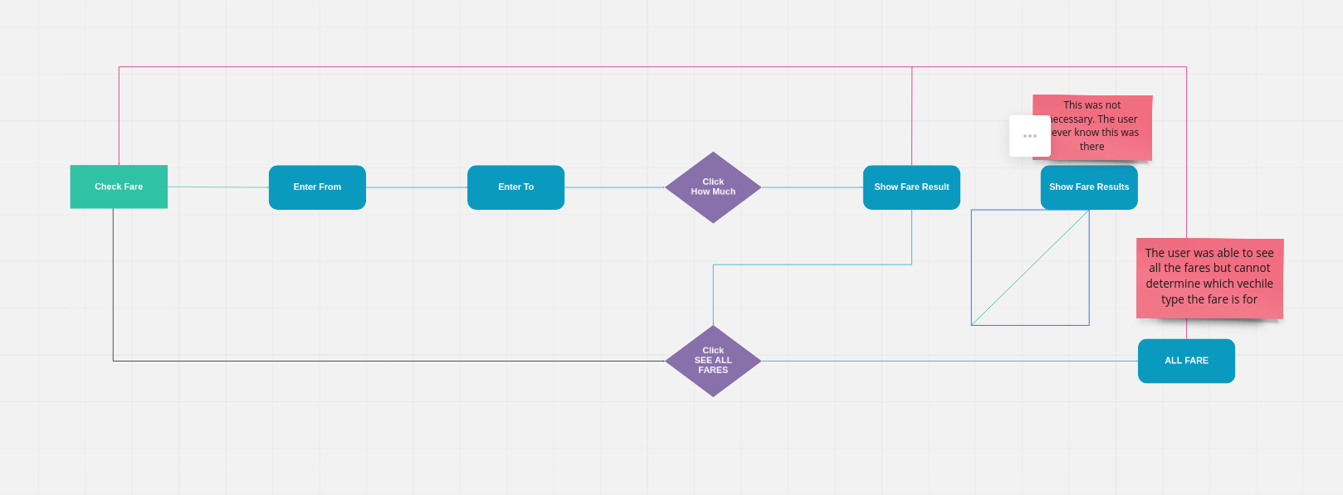
Design: Concepts & Sketching
User Flow
After having some views, I define a user flow (from start to finish and all the different directions they can take) to see the steps a user takes through to complete tasks. Here, I've shown the flow a user takes to search for a fare and a link to all fares.

Slide 10
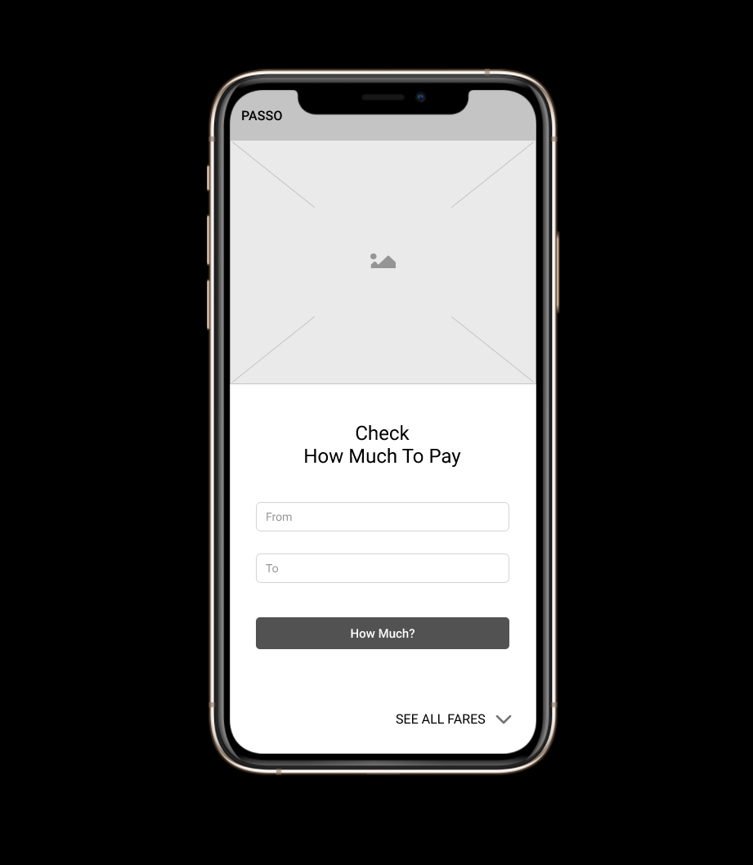
Develop: Prototyping
After defining possible user flows, I created a simple clickable prototype (using figma) based on the states of the flow to test with the users.
Figma Prototype URL:
View prototype

Slide 11
Test: Validation, Usability, Feedback
I learned the following from the usability study:
- The user was confused with the two fare results page
- On the ALL FARES page, the user couldn't determine the fare is for which vehicle type.
When I conducted further usability studies, other issues also were discovered. For example, nearly 100% of the users cannot quickly check for the fare on the ALL FARES page because it takes time to scroll to find the fare they are checking up.
100%
75%
25%
25%

Slide 12
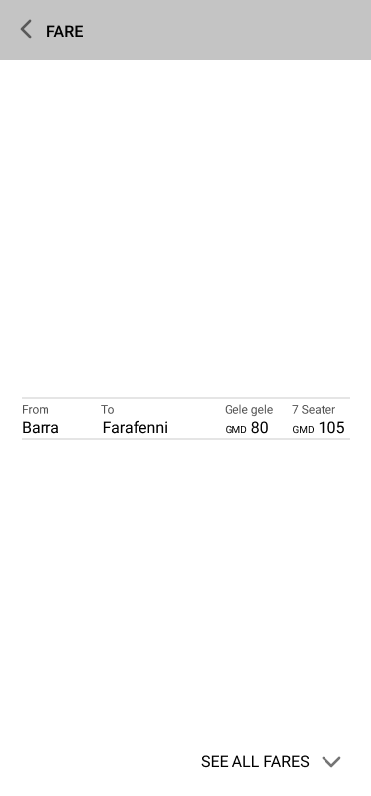
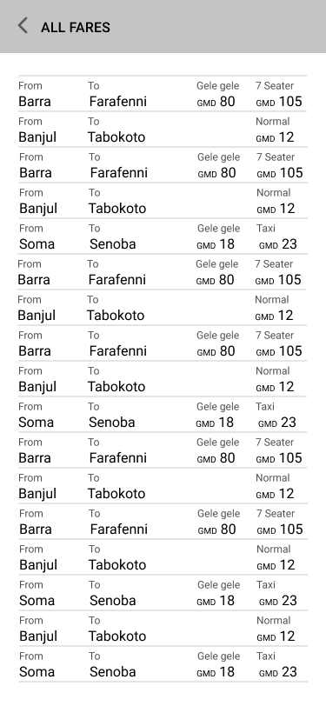
Design: Iteration
I took the insights and feebacks from the usability testing and went back to refine my designs. I removed the the redundant multiple fares results page and show localities against fares.

Slide 13
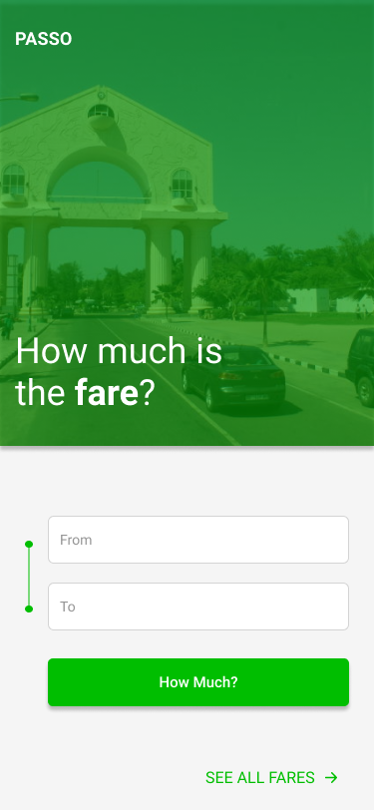
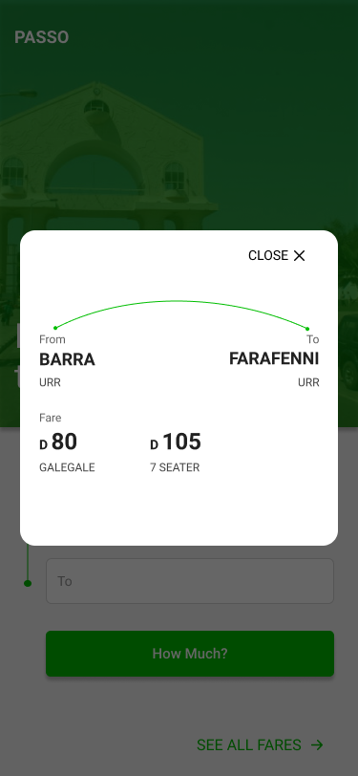
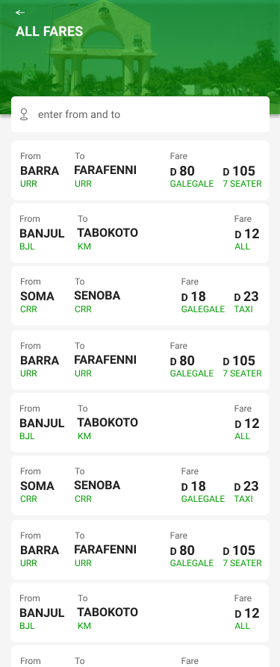
Solution & Impact Overview
Final solutions. Next, I will work on the designs for large desktop and start implementing the code.

Slide 14
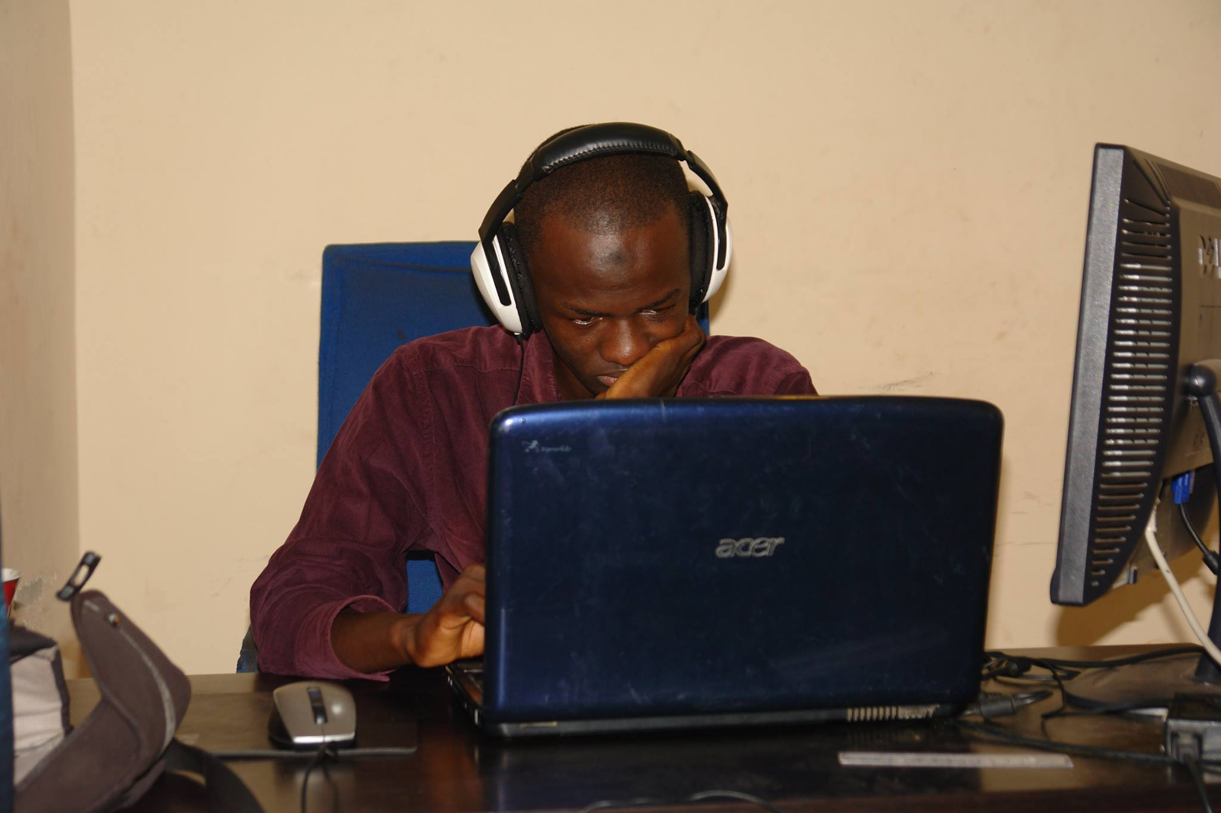
About Me
Peace, I'm A. Camariana, haling from the Gambia. I'm a UX Designer and Front-end Developer.
Blending a background in computer science and human centered design with love for faith and developer education, I work with startups to find solutions through design, front-end development and training.
You can get intouch with me at camariana40@outlook.com

